Slide 1
SHYAMA PRASAD MUKHERJEE PORT TRUST
ONLINE RFID USER MANUAL

Slide 2
CONTENT
RENEWAL OF COMPANY VALIDITY.
CREATE USER ID AND PASSWORD.
COMPANY DASHBOARD.
CREATE OF ORDER NO.
PROCESS FOR PERTAINING DAILY PERMIT.
USER ENTRY/EXIT SYSTEM AT KDS.
VEHICLE ENTRY/EXIT SYSTEM AT KDS

Slide 3
RENEWAL OF COMPANY VALIDITY

Slide 4
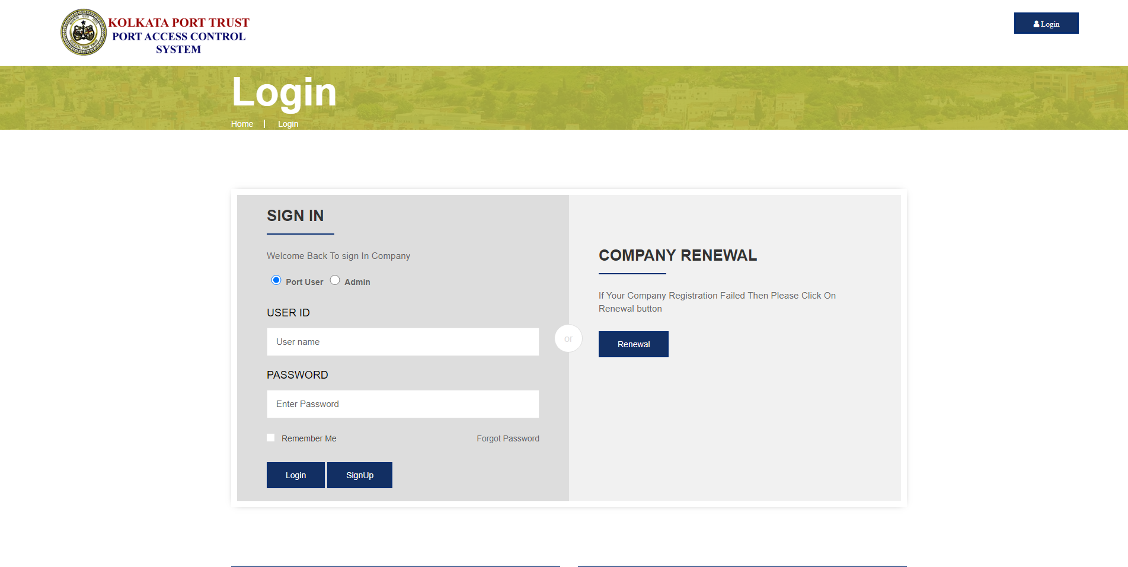
COMPANY RENEWAL
GO TO RFID WEBSITE – https://www.koptrfid.in → CLICK ON LOGIN
CLICK ON RENEWAL
*IF COMPANY IS EXPIRED

Slide 5
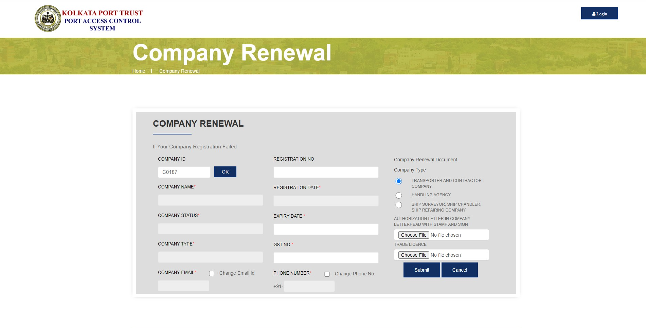
ENTER COMPANY ID → CLICK ON “OK” BUTTON

Slide 6
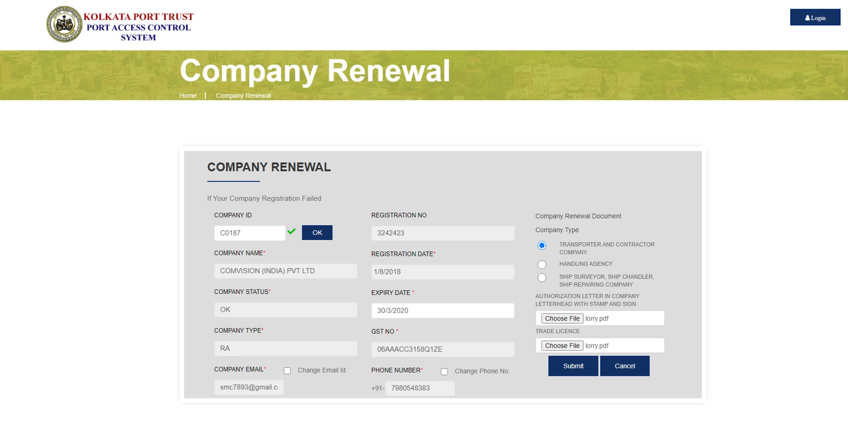
CHOOSE COMPANY TYPE
UPLOAD DOCUMENTS *IN PDF FORMAT
CLICK ON SUBMIT

Slide 7
CREATE LOGIN CREDENTIALS

Slide 8
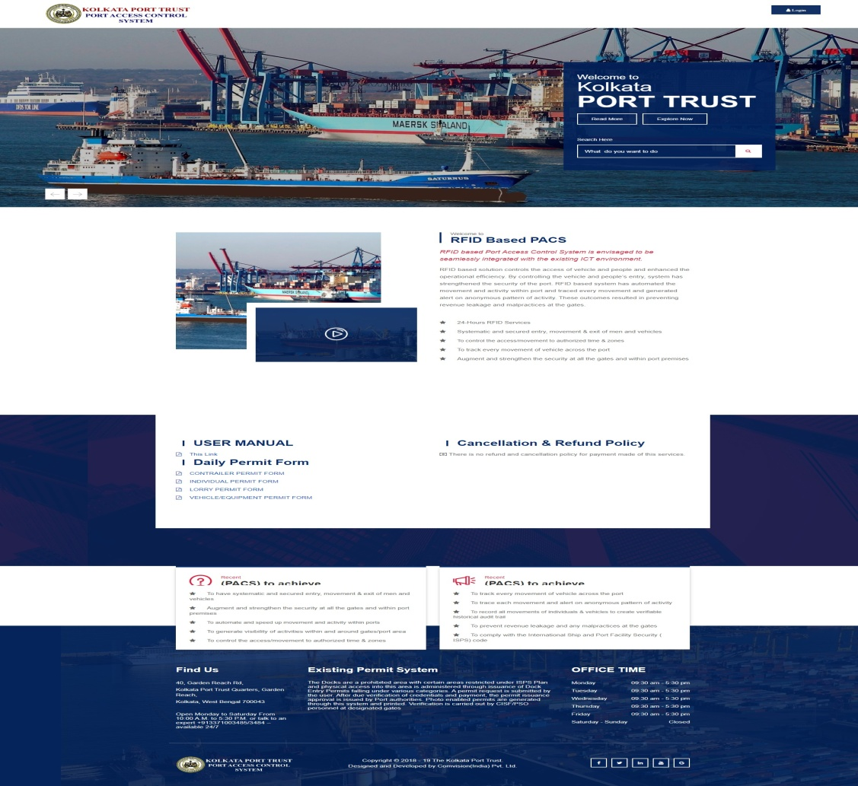
CREATE USER ID AND PASSWORD
GO TO RFID WEBSITE – https://www.koptrfid.in
CLICK ON LOG IN

Slide 9
THEN CLICK ON SIGN UP BUTTON

Slide 10
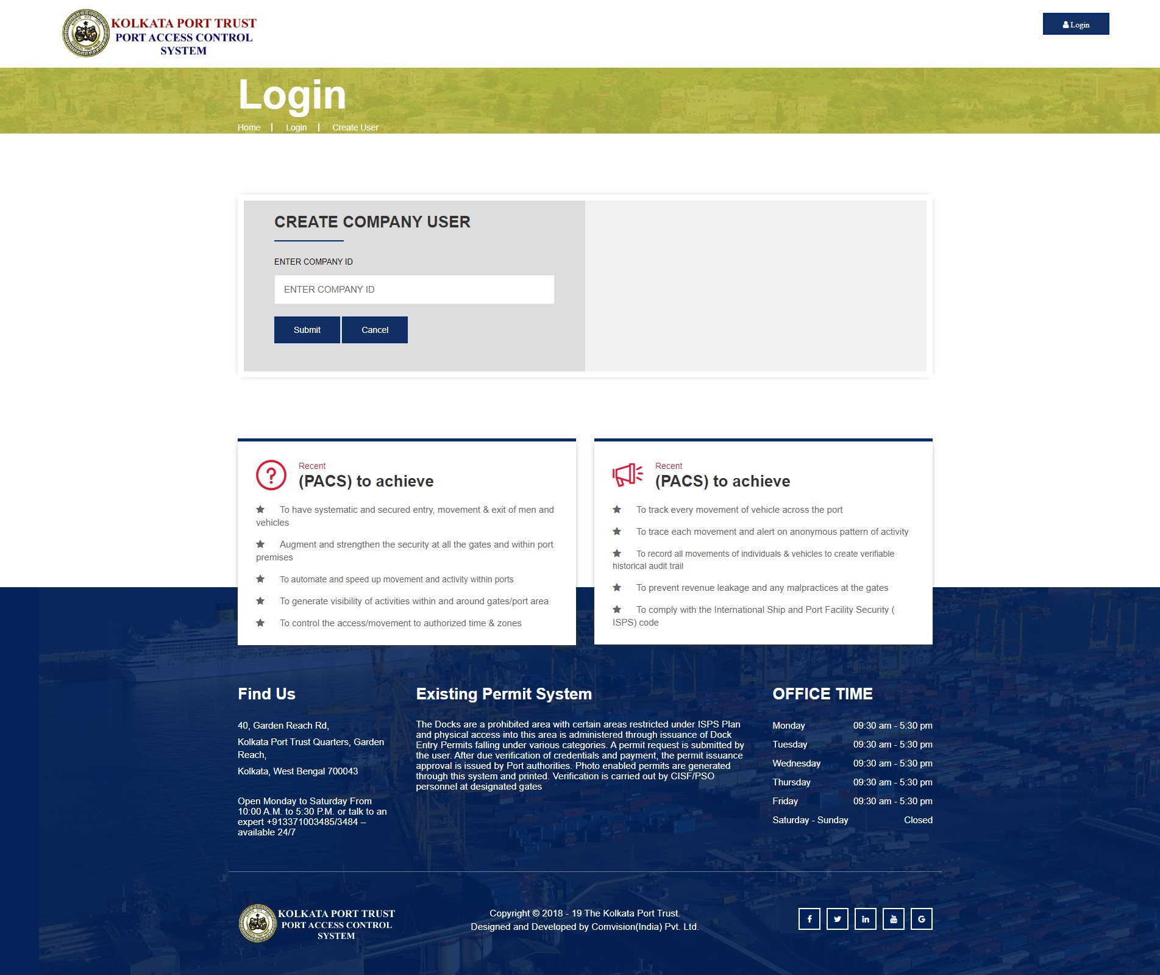
ENTER COMPANY ID
CLICK ON SUBMIT

Slide 11
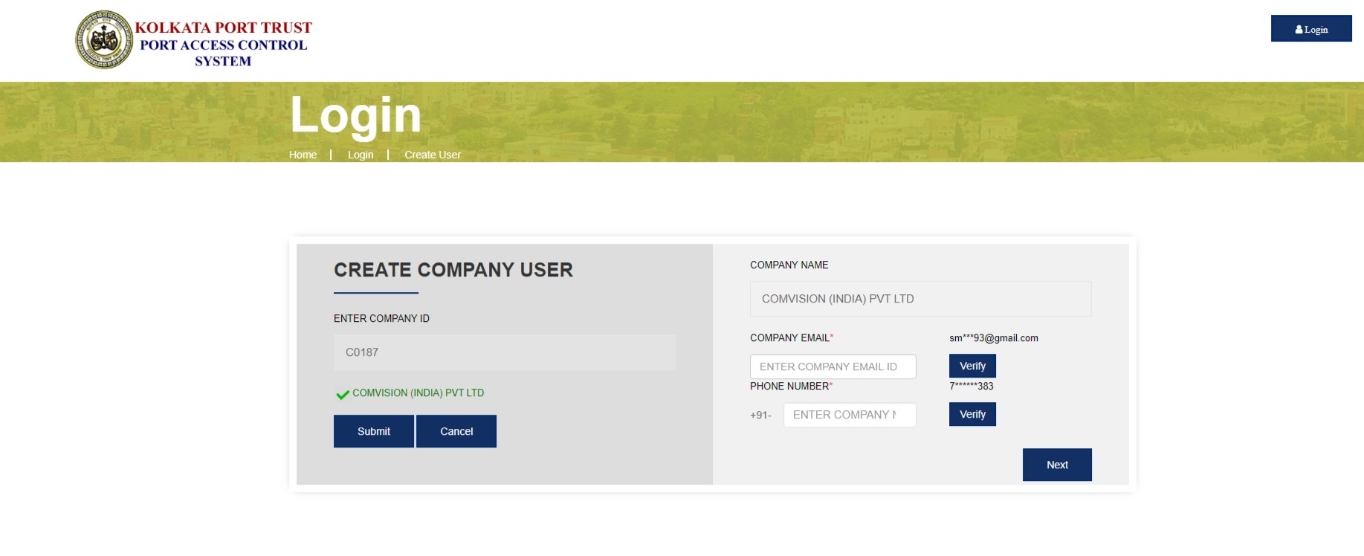
VERIFY EMAIL ID
VERIFY MOBILE NO
CLICK ON NEXT

Slide 12
ENTER COMPANY ID
*DO NOT USE ANY SPECIAL CHARACTER FOR CREATING USER ID
CREATE USER ID
CREATE PASSOWRD
RE-ENTER SAME PASSWORD
CLICK ON SUBMIT
COMPANY USER ID AND PASSWORD CREATED SUCCESSFULLY

Slide 13
USER DASH BOARD

Slide 14
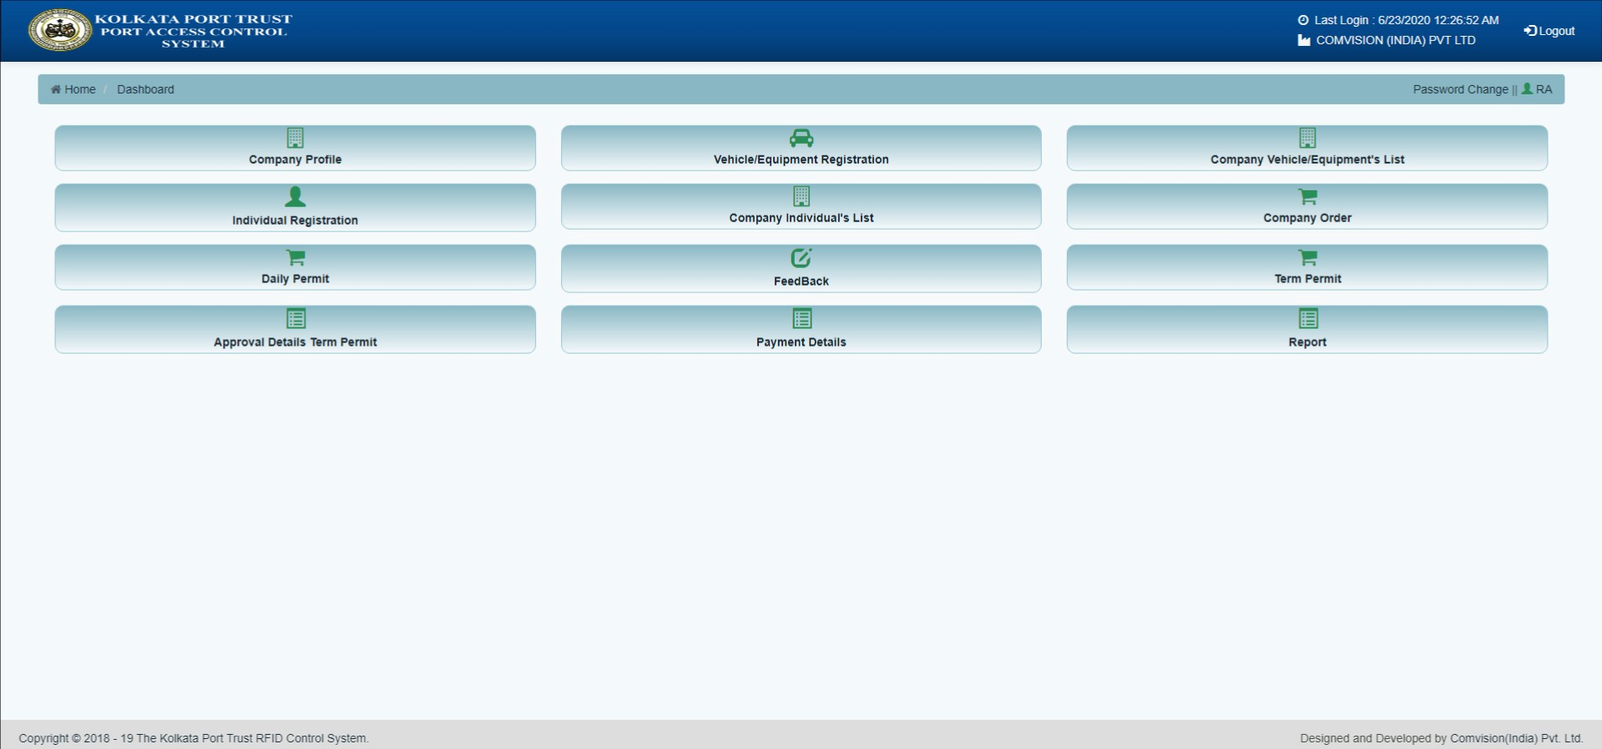
DASHBOARD

Slide 15
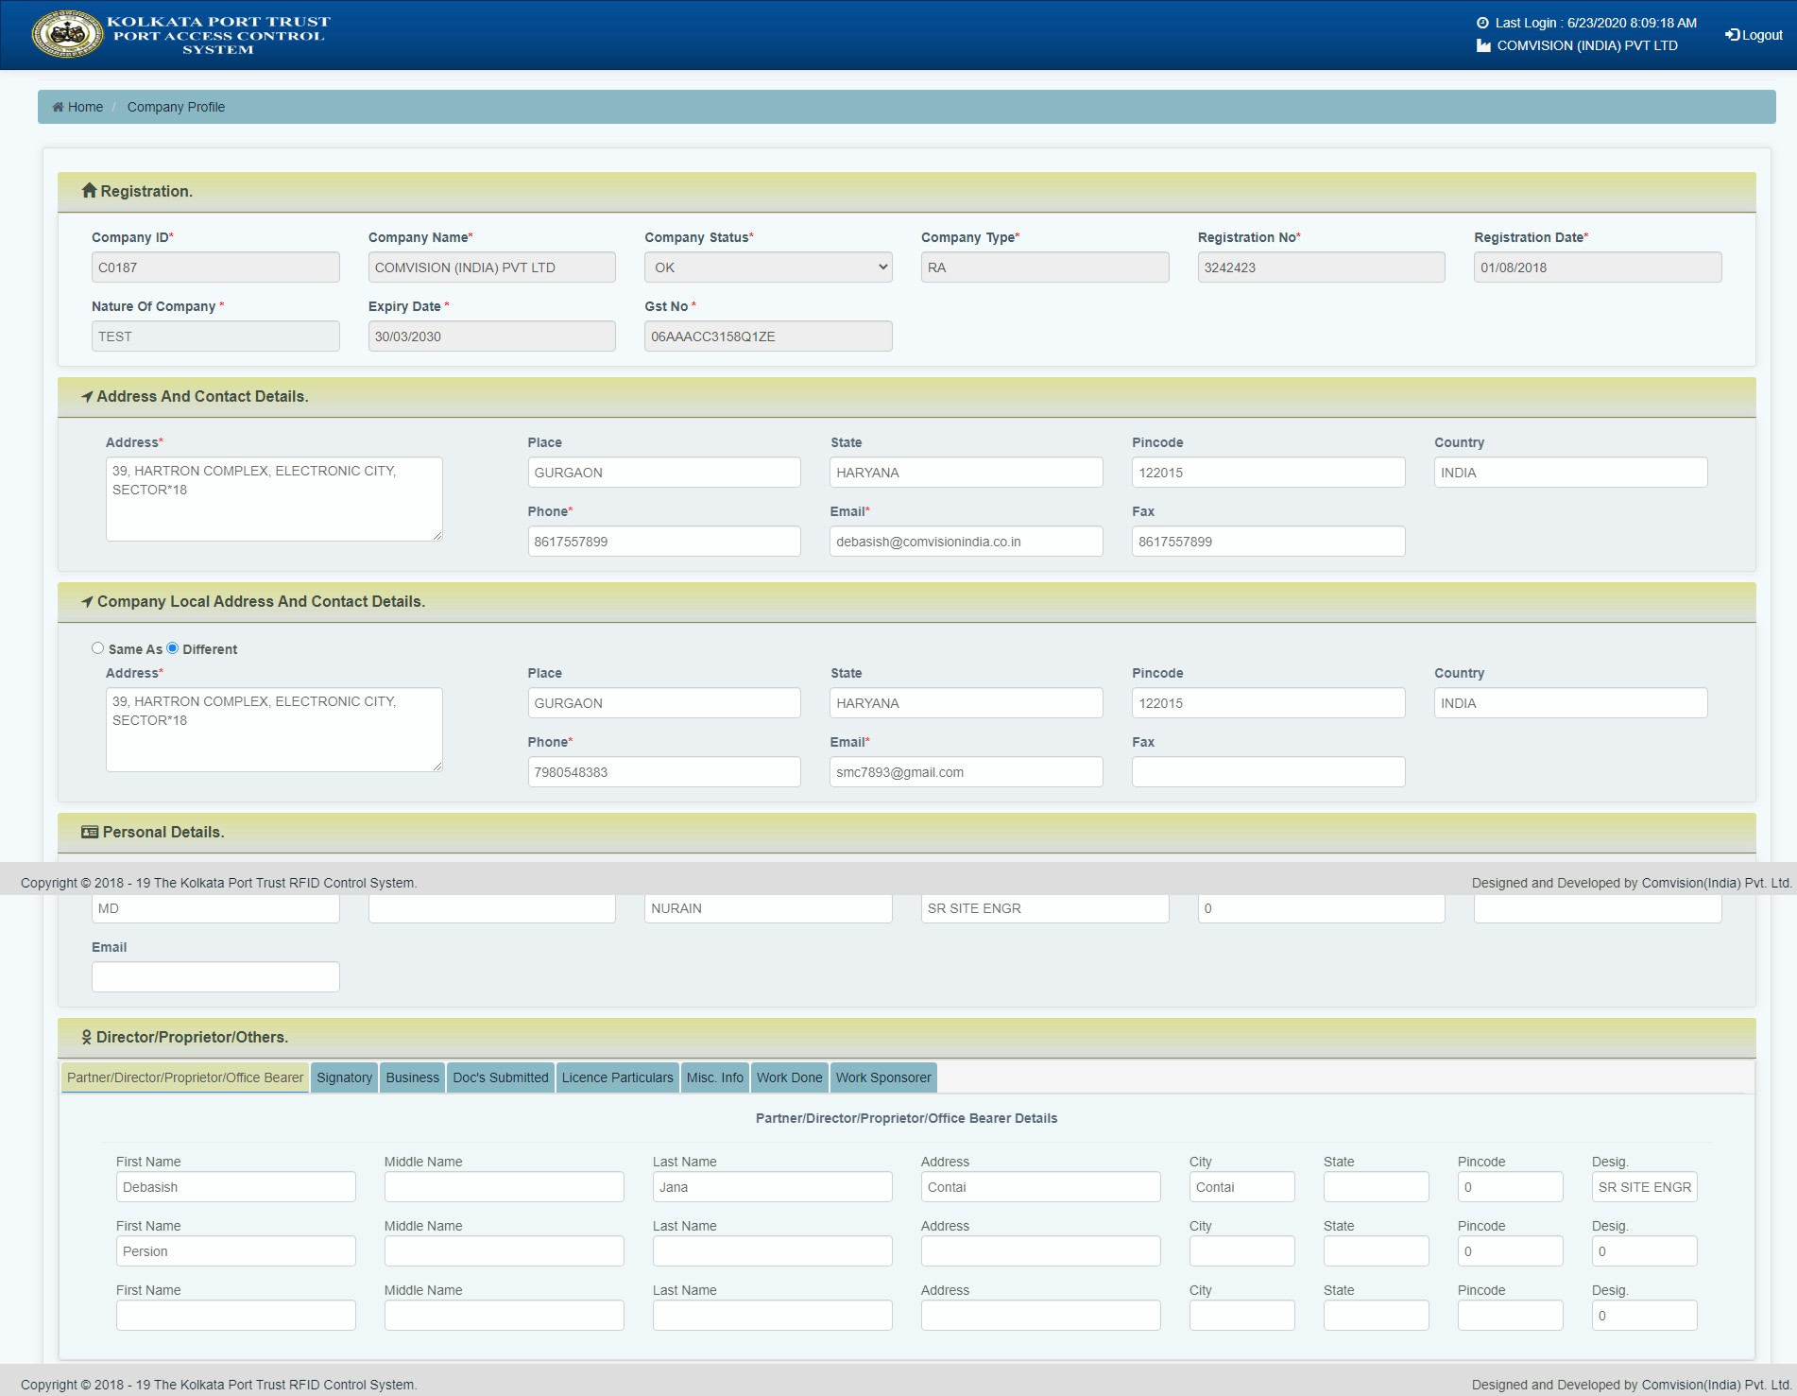
Company Profile Page

Slide 16
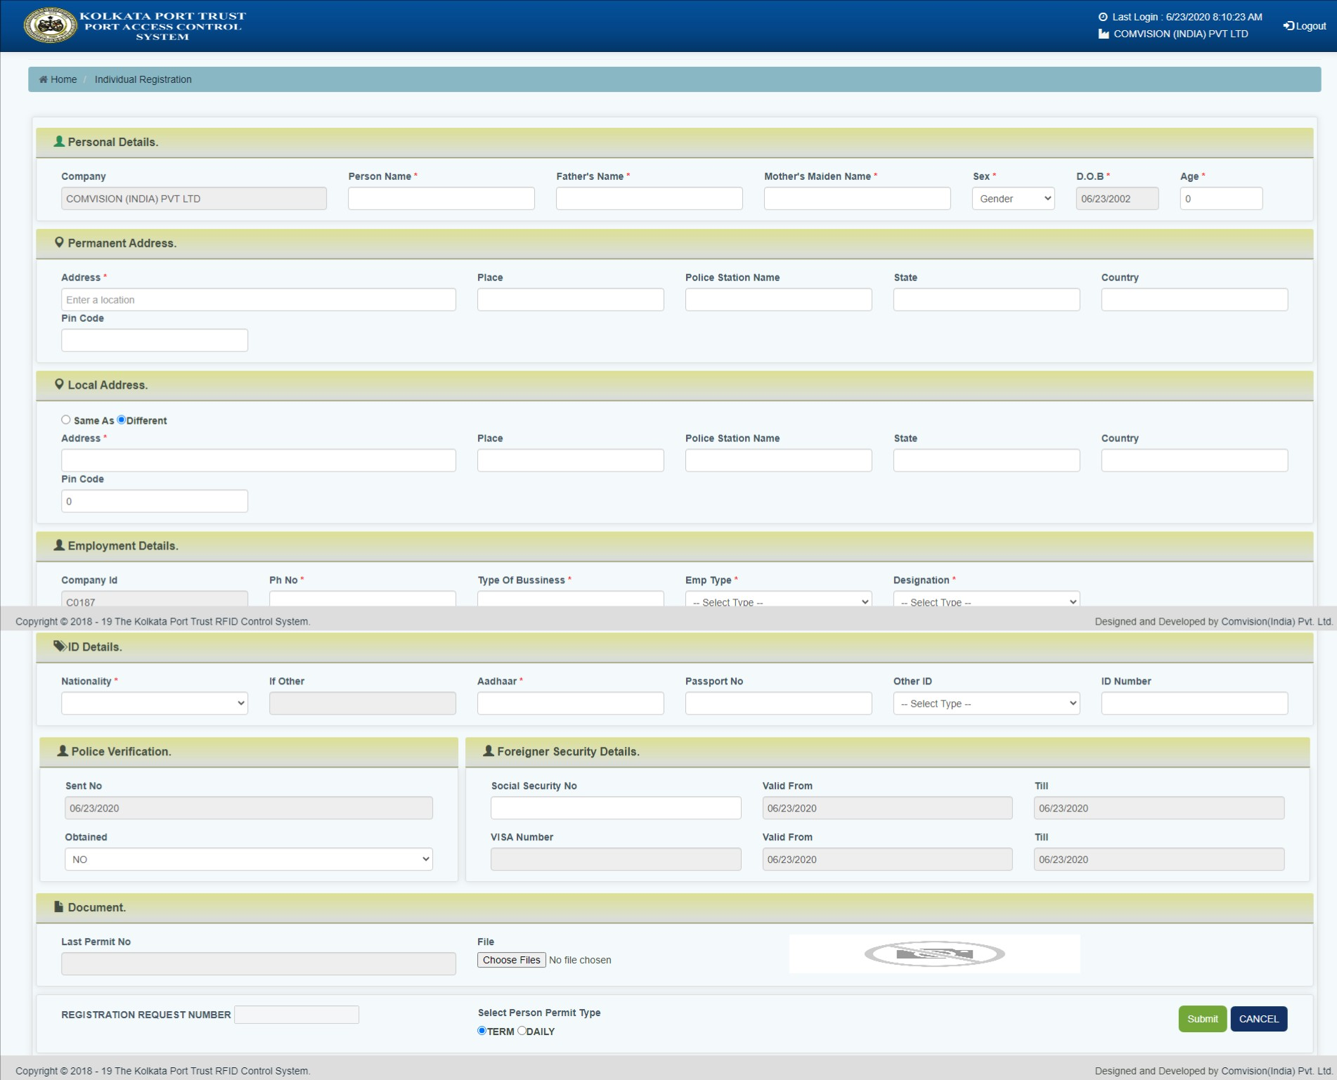
Individual Registration Page

Slide 17
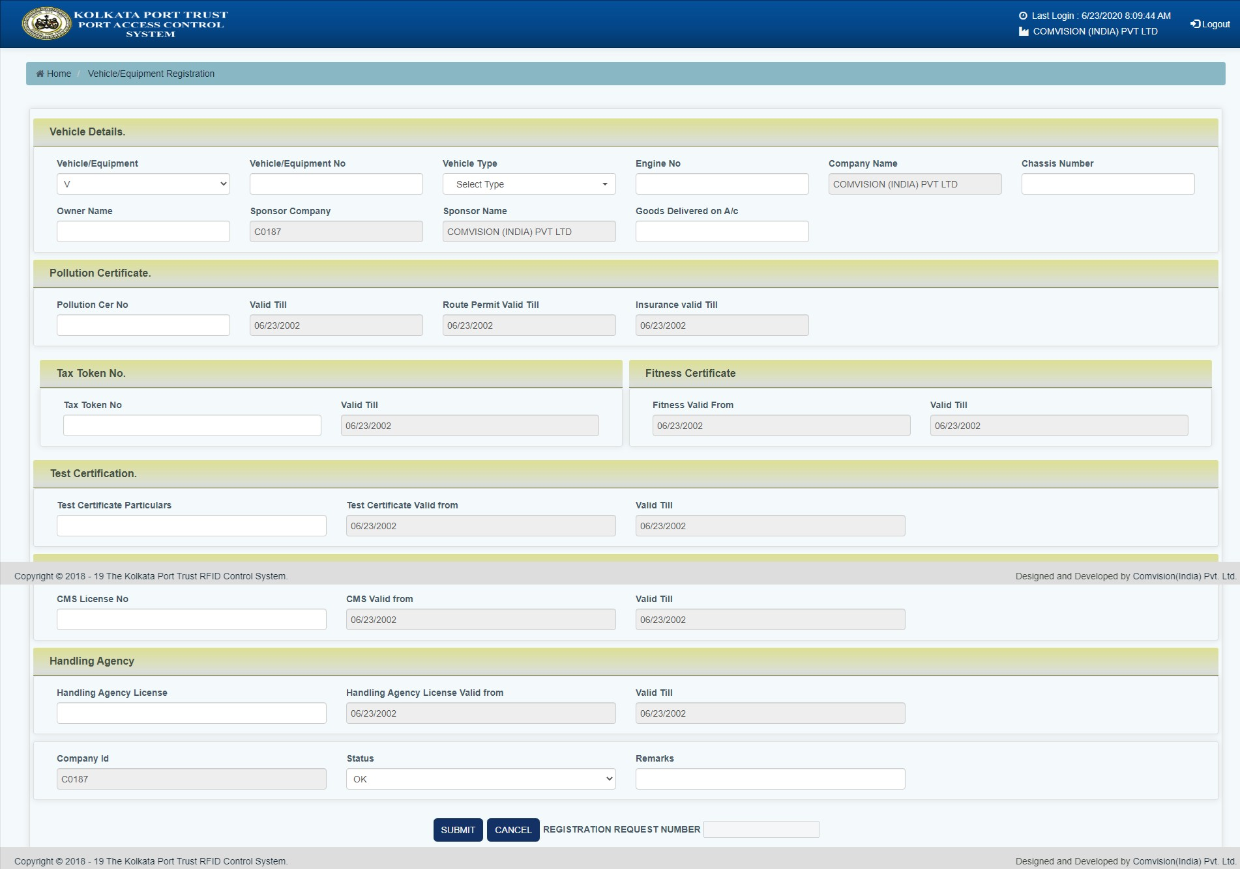
Vehicle Registration Page

Slide 18
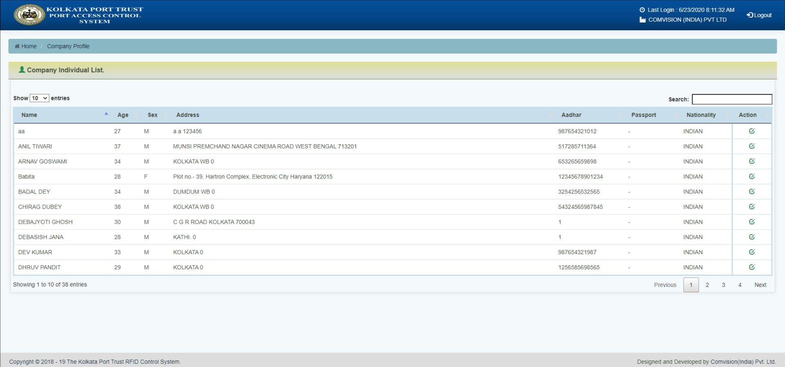
Company Individual’s List

Slide 19
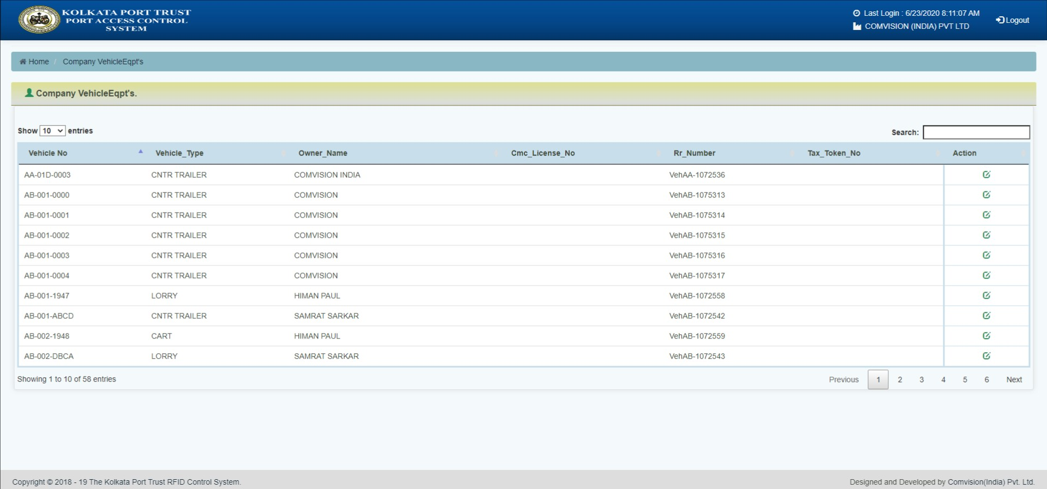
Company Vehicle’s List

Slide 20
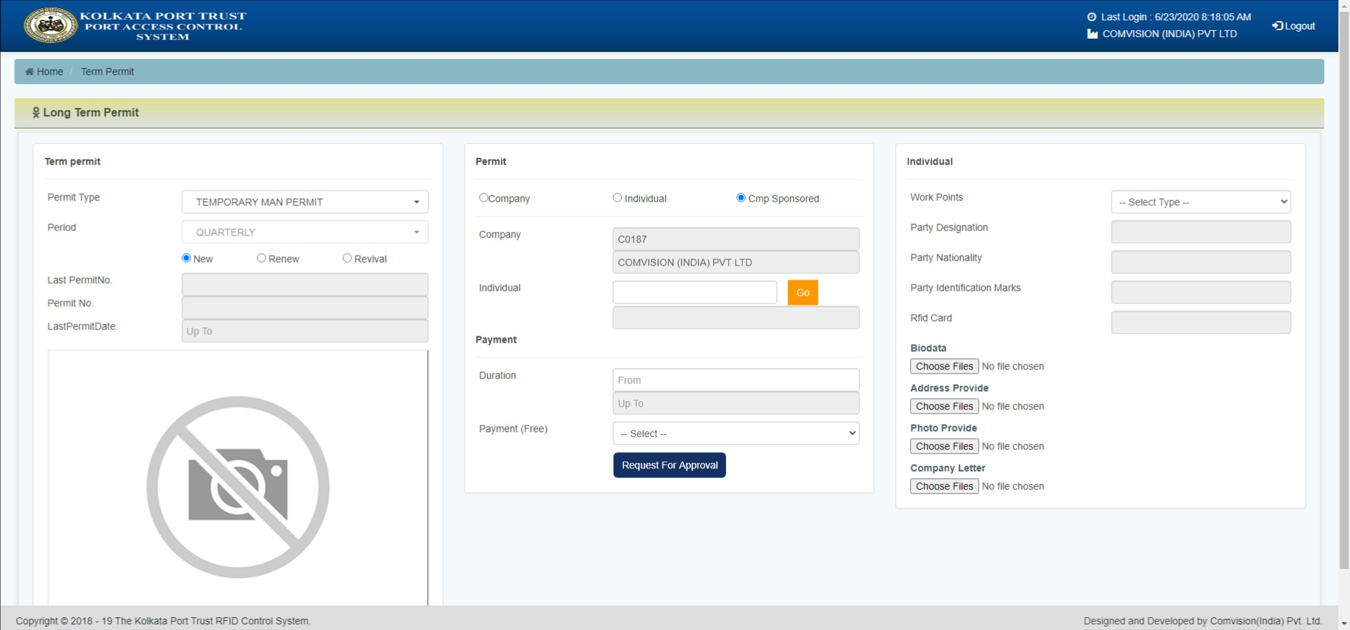
Long Term Permit Page (For New Application)

Slide 21
Long Term Permit Page (For Renewal Application)
*
*For Renewal of Long Term Permit, Last Permit Number is Mandatory

Slide 22
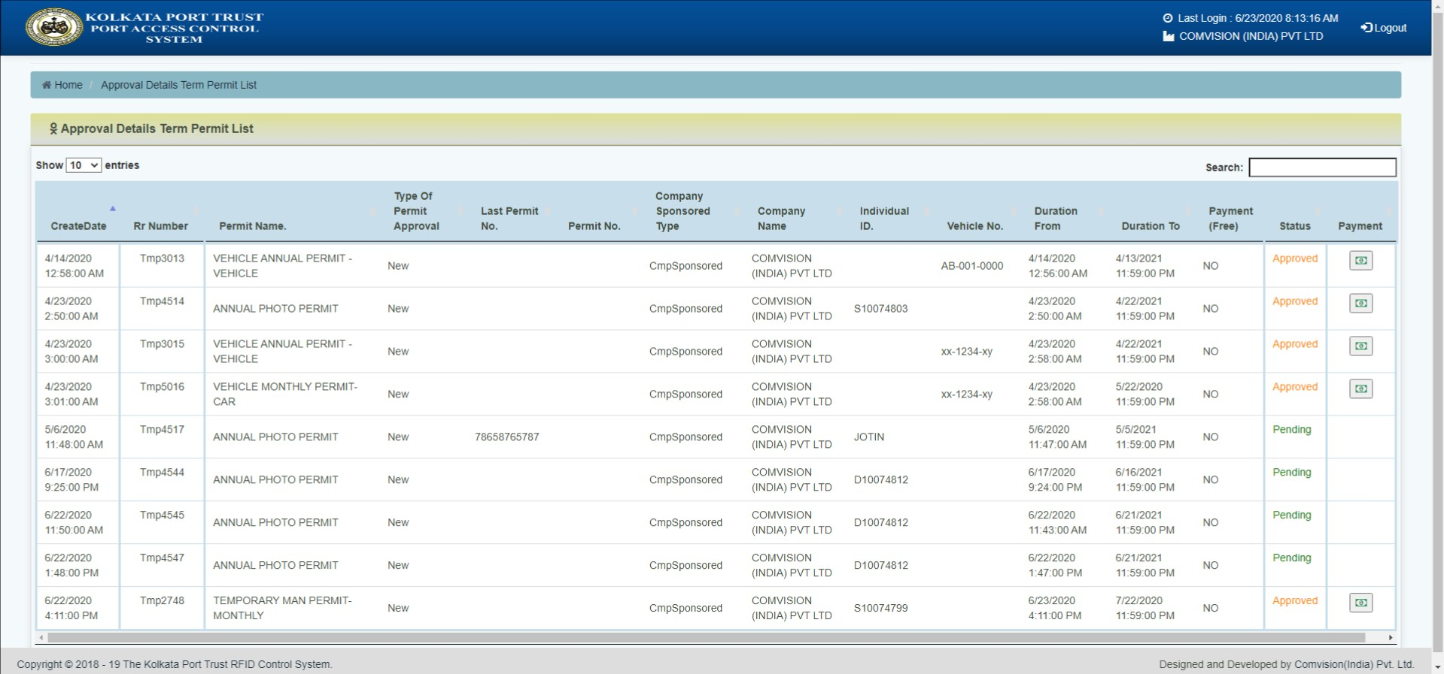
Long Term Permit Approval Status Page

Slide 23
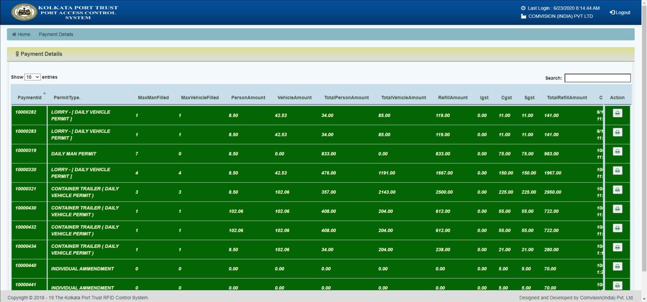
Payment Details Page

Slide 24
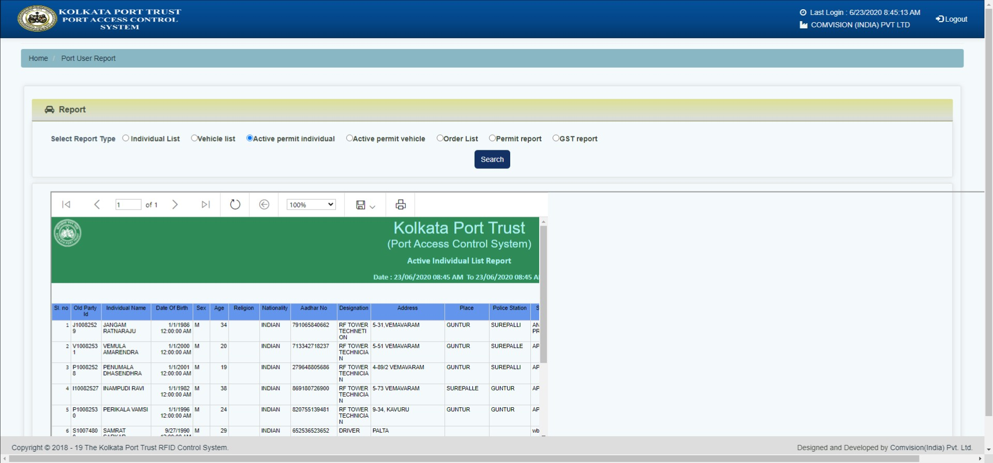
Report Page

Slide 25
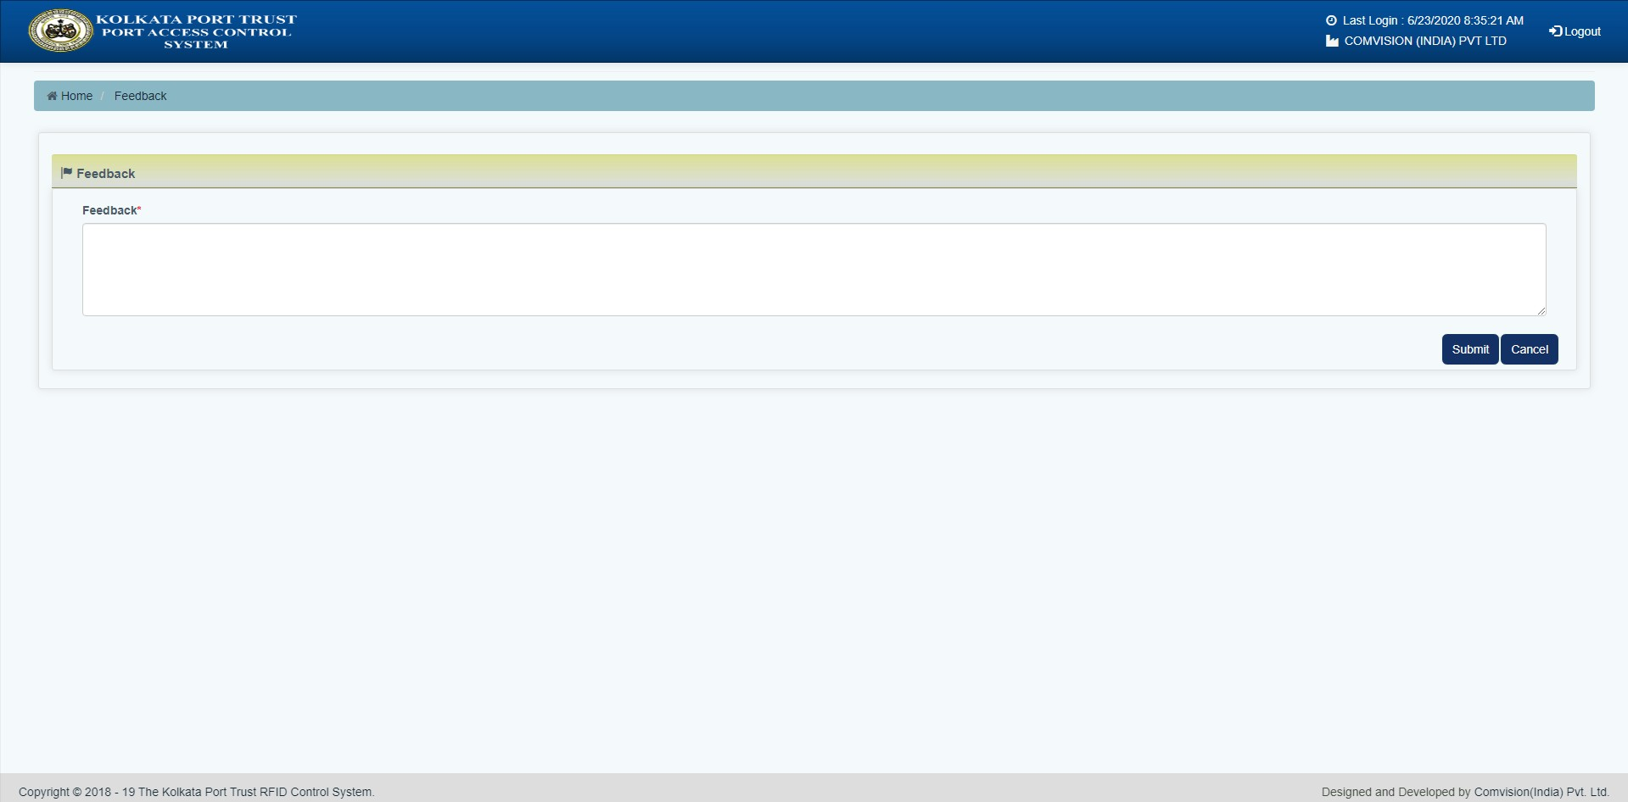
Feedback Page

Slide 26
CREATE ORDER ID

Slide 27
CREATE ORDER NO.
GO TO RFID WEBSITE – https://www.koptrfid.in & LOGIN
CLICK ON COMPANY ORDER

Slide 28
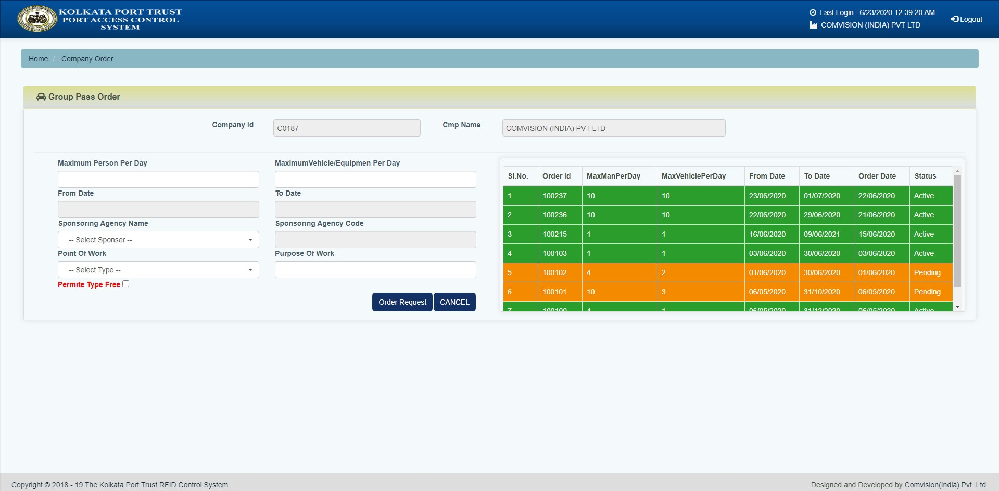
ORDER ID PAGE

Slide 29
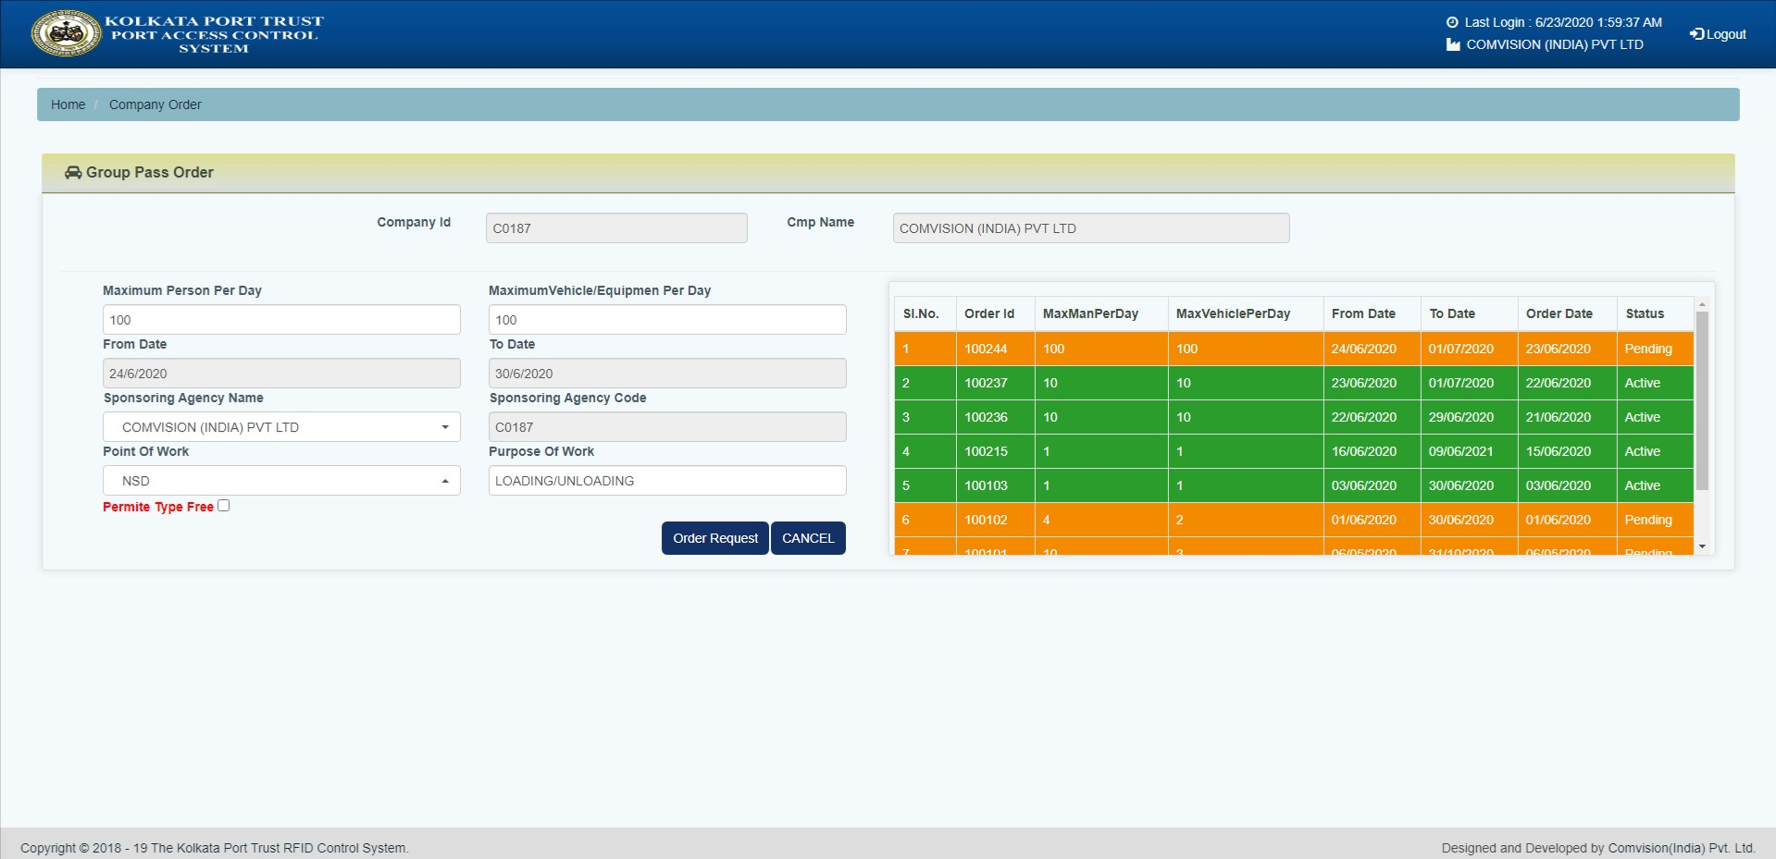
FILL UP EVERY DETAILS→AND PRESS ORDER REQUEST

Slide 30
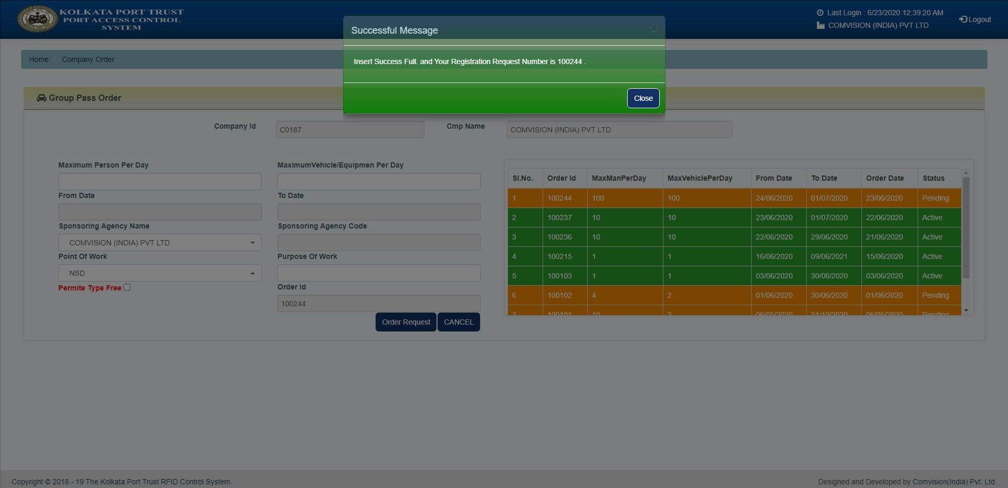
*POP UP DISPLAY WILL SHOW SUCCESSFUL MESSAGE WITH ORDER NO

Slide 31
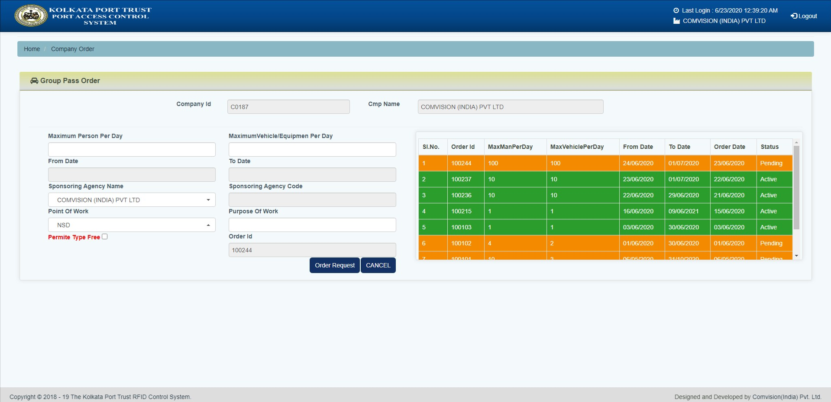
AFTER CREATING ORDER NO → ONE CAN CHECK ITS STATUS IN ORDER ID PAGE

Slide 32
DAILY PERMIT

Slide 33
STEPS :DAILY PERMIT
GO TO RFID WEBSITE – https://www.koptrfid.in
CLICK ON LOG IN

Slide 34
ENTER USER ID
ENTER PASSWORD
CLICK ON LOG IN

Slide 35
COMPANY DASHBOARD
CLICK ON DAILY PERMIT

Slide 36
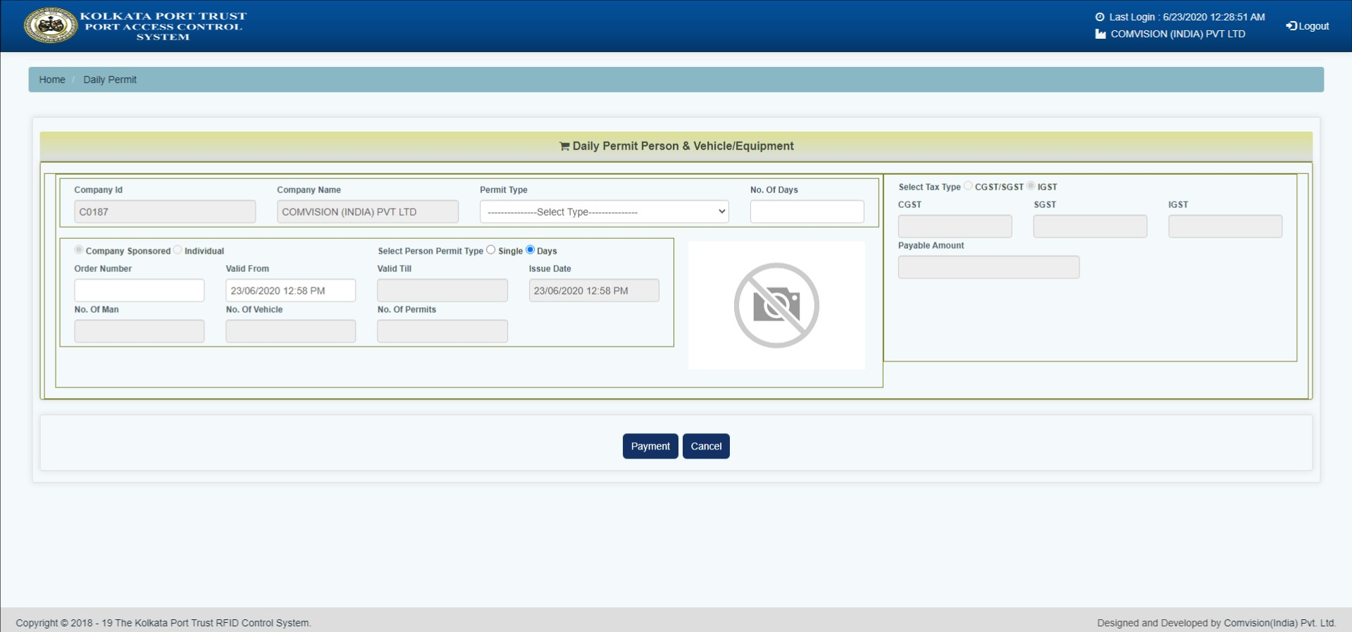
DAILY PERMIT PAGE

Slide 37
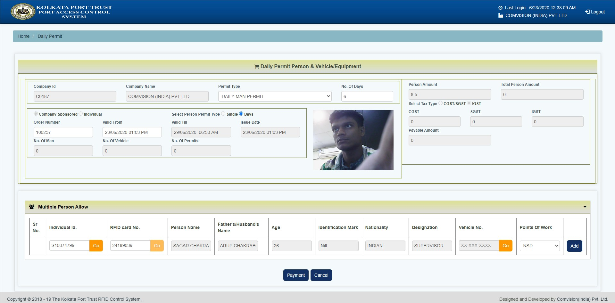
FILL UP DAILY PERMIT DETAILS
1. CHOOSE PERMIT TYPE
3. ENTER NO. OF DAYS
2. ENTER ORDER NUMBER
4. SELECT VALID FROM
7. CHOOSE POINT OF WORK
5. ENTER INDIVIDUAL ID → THEN PRESS GO
6. ENTER VEHICLE NO IF INDIVIDUAL IS DRIVER → THEN PRESS GO
* ORDER NO ONLY REQUIRED IF ASKED
8.CLICK ON ADD

Slide 38
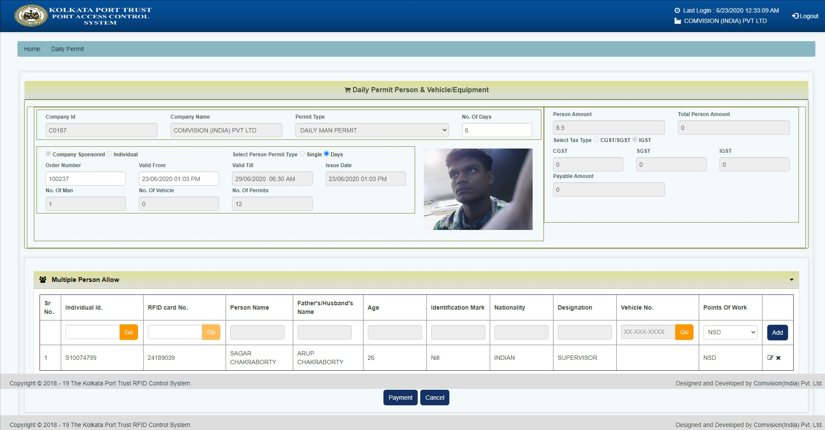
CLICK ADD BUTTON
CLICK ON PAYMENT BUTTON

Slide 39
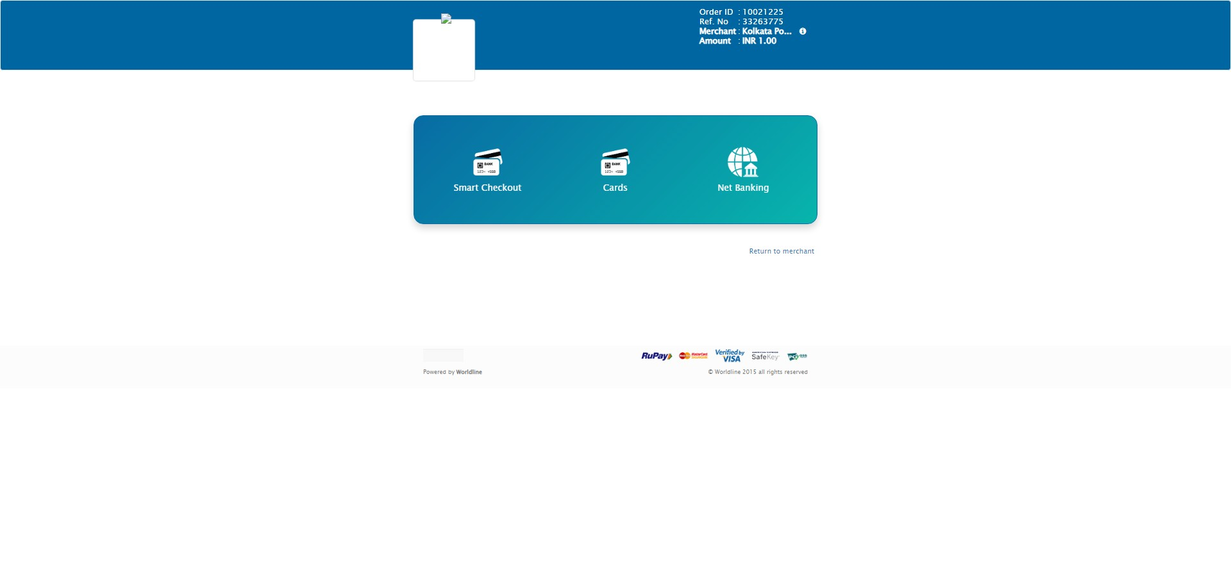
PAGE WILL DIRECT TO PAYMENT GATEWAY OPTION
CHOOSE PAYMENT OPTION

Slide 40
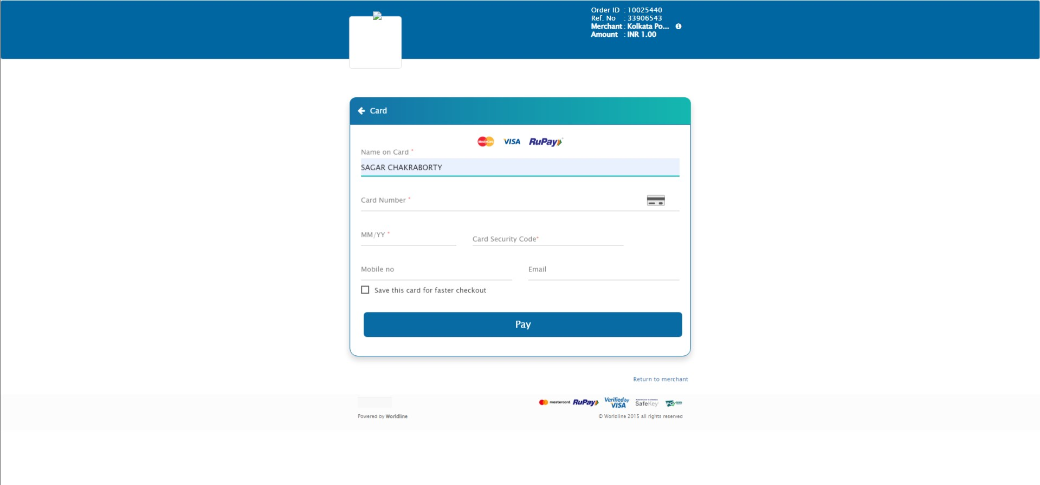
MODULE FOR CARD OPTION
ENTER DETAILS
CLICK ON PAY

Slide 41
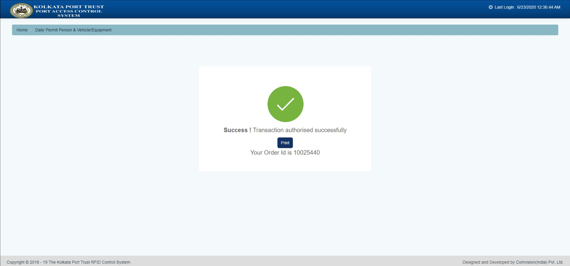
PAYMENT SUCCESSFUL MASSAGE
CLICK ON PRINT TO GET INVOICE

Slide 42
INVOICE WITH PERMIT DETAILS
CLICK ON THIS TO GET PDF

Slide 43
USER ENTRY/EXIT SYSTEM

Slide 44
User entry/exit system
RFID HF cardholders – Pedestrian lane by flashing RFID card at reader.
Registered Individual’s details -LED display
4. After Checking permit validity individual can pass through tripod.

Slide 45
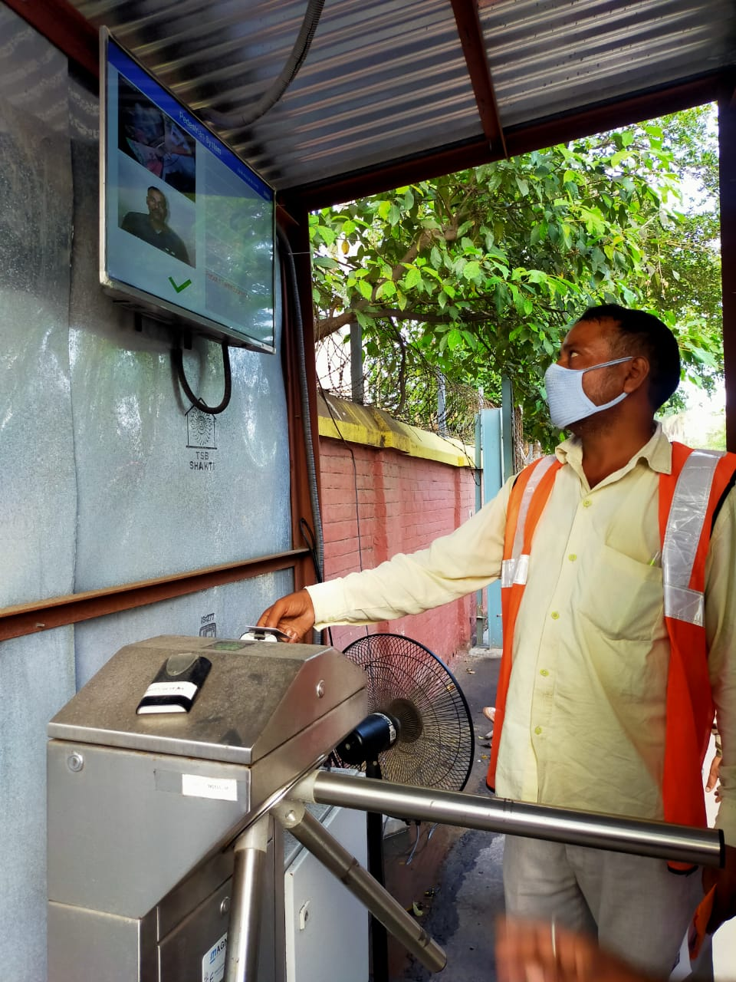
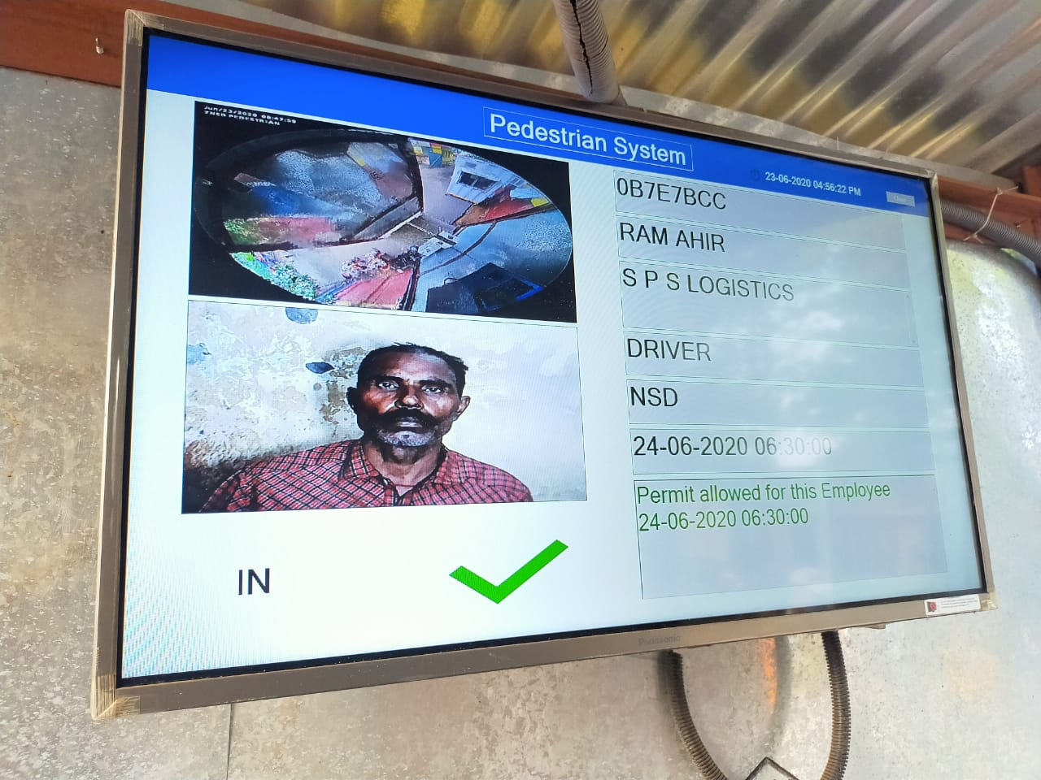
PEDESTRIAN LANE PROCESS
1. RFID CARD READ BY HF CARD READER
2. PERMIT IS VALID

Slide 46
VEHICLE ENTRY/EXIT SYSTEM

Slide 47
VEHICLE LANE SECURITY PROCESS
RFID UHF tag for vehicle- vehicle lane .
Registered Vehicle’s details – validate security check point.
After Checking permit validity -Vehicle can pass through barrier.

Slide 48
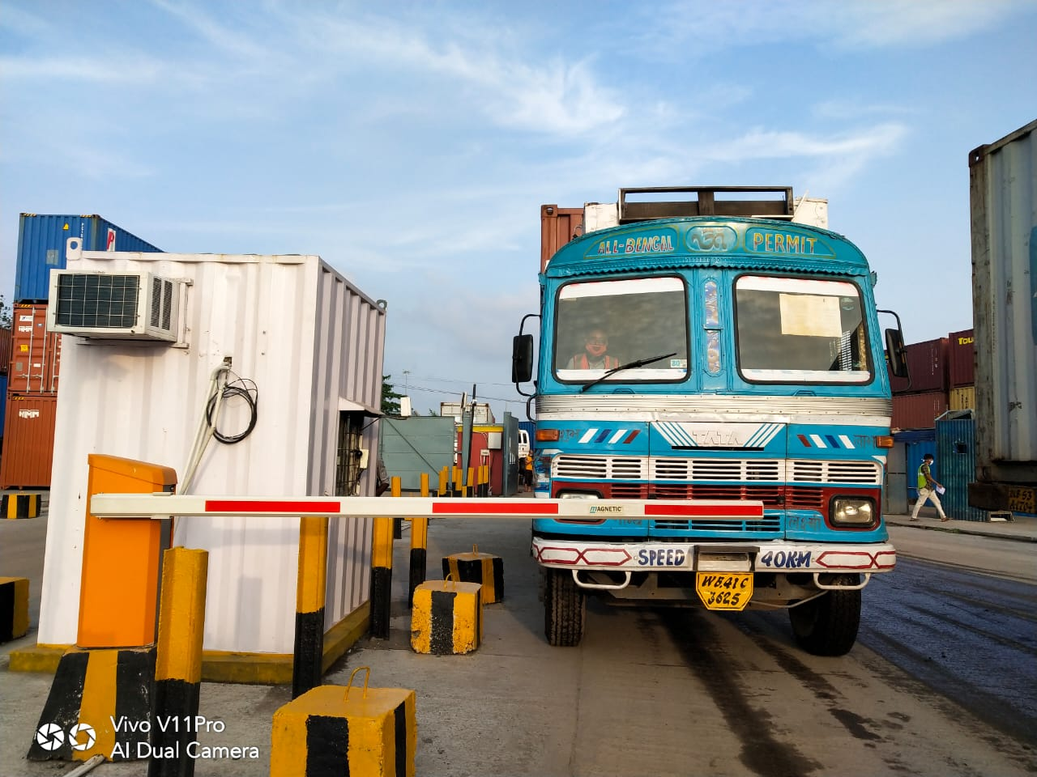
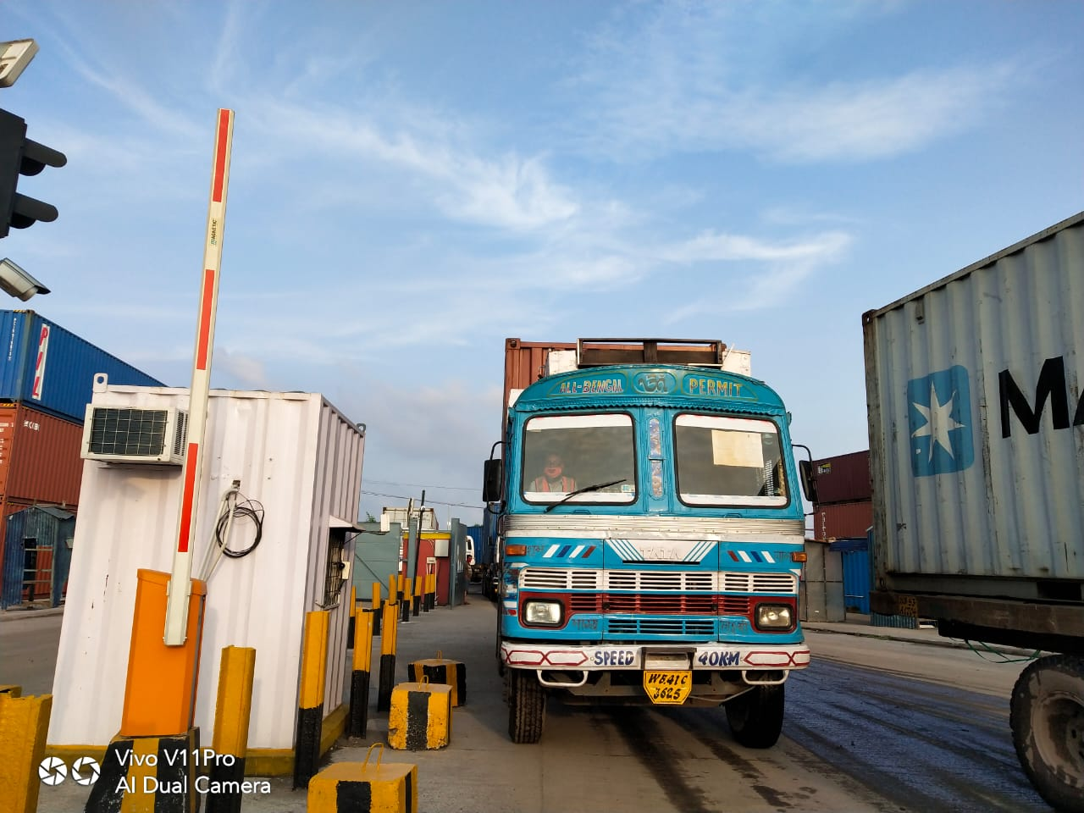
VEHICLE LANE PROCESS
1. VEHICLE REACHED AT RFID GATE
2. BOOM BARRIER OPENED
SYSTEM CHECKED THE PERMIT

Slide 49
THANK YOU

